Slide 1
Logistic Regression
Machine Learning
Supervised – Classification – Binary classification

Slide 2
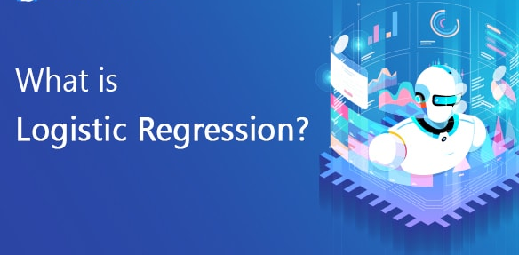

Slide 3
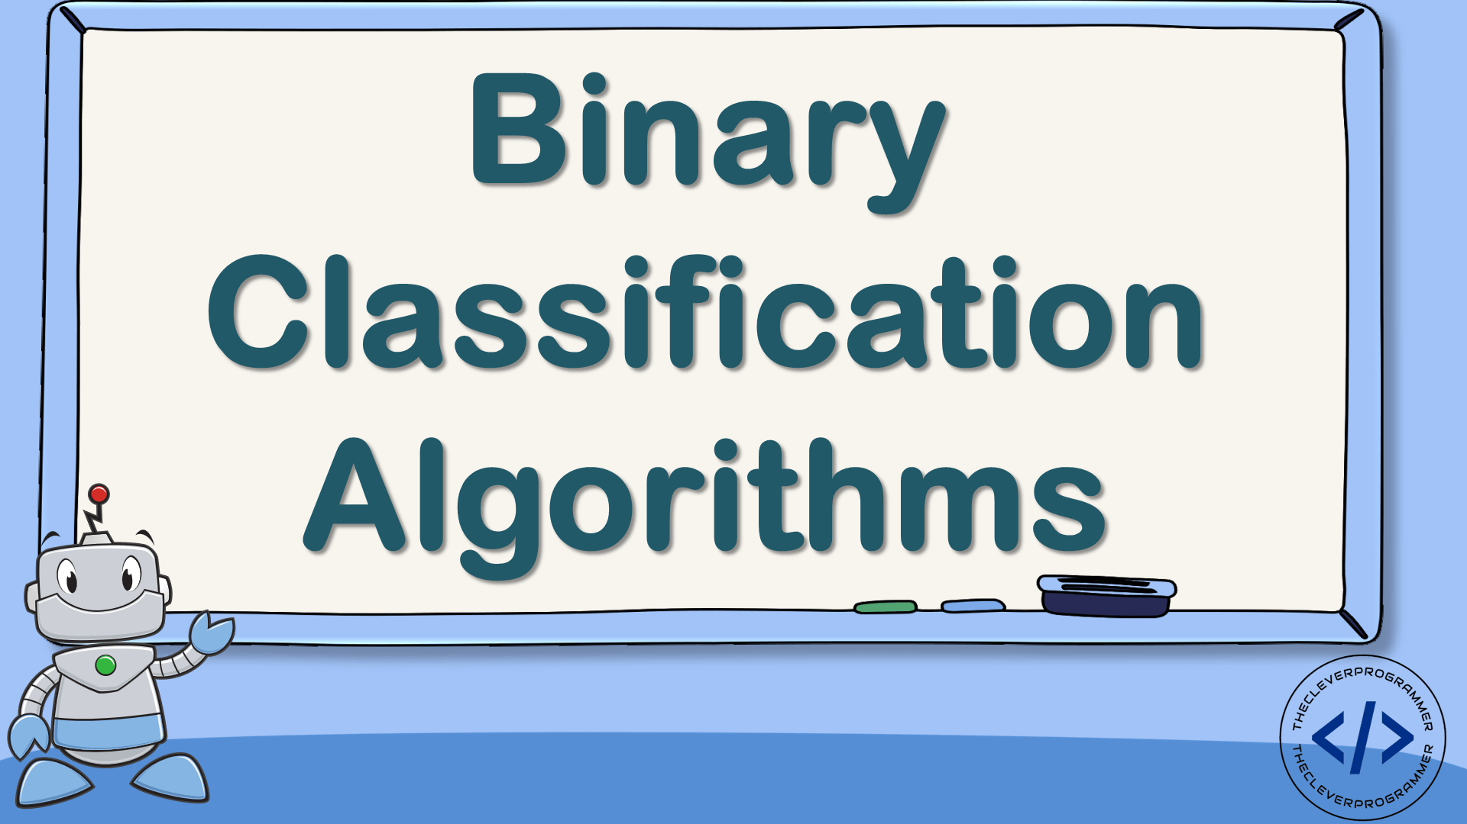

Slide 4
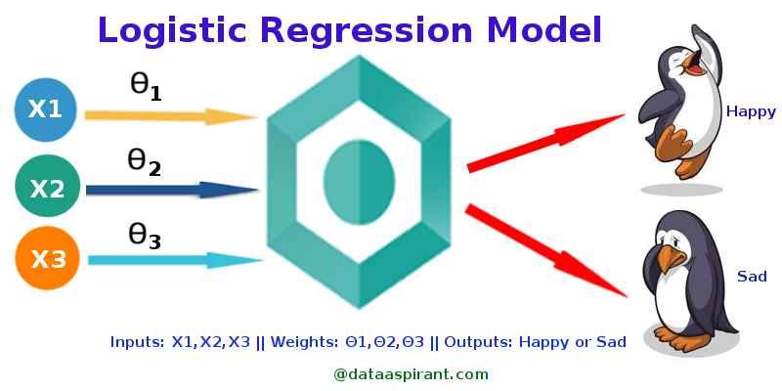

Slide 5
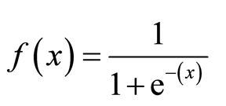
Sogmoid Function

Slide 6
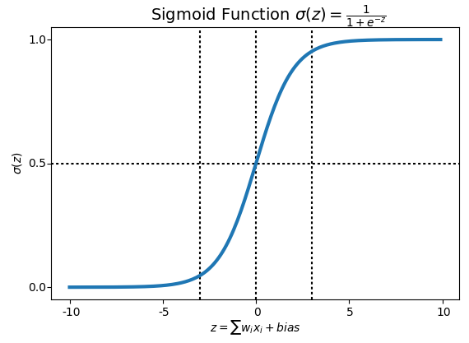

Slide 7
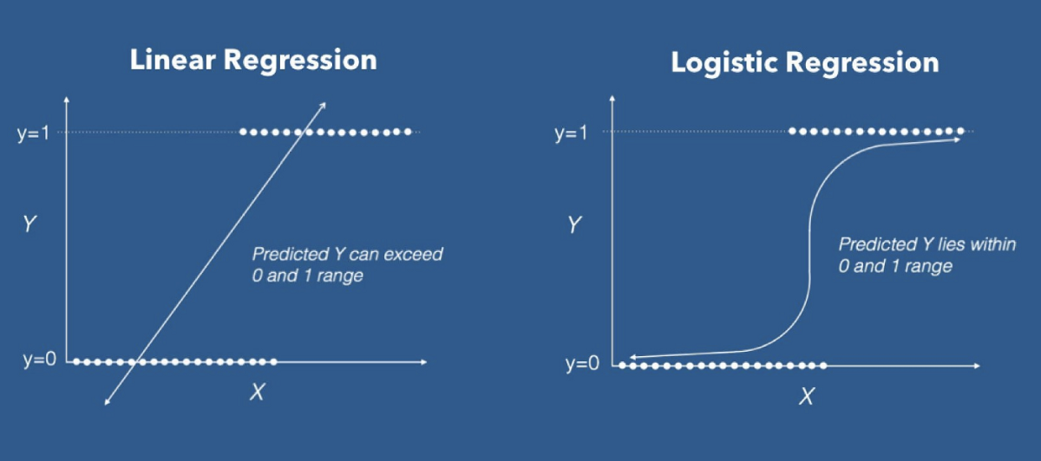

Slide 8
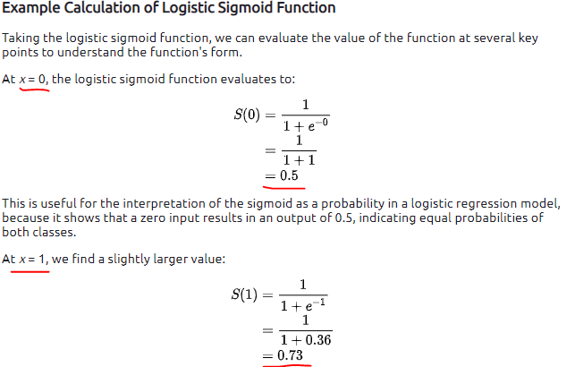

Slide 9
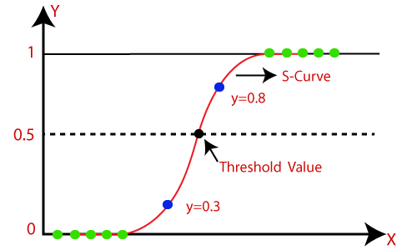

Slide 10
Y -Predicted Near to
0 or 1
0 = False or No
1 = True or Yes

Slide 11
Now let’s Code

